Slide 1
2. Data science overview
Youngsoo Kim <pineland@hanmail.net>
Code : https://github.com/pineland/AIDA/

Slide 2
Contents
Data science concepts
Big data concepts
Platform of big data: Hadoop
Data sources
Process of data science

Slide 3

빅데이터 활용해 범죄 재발 막겠다!

Slide 4
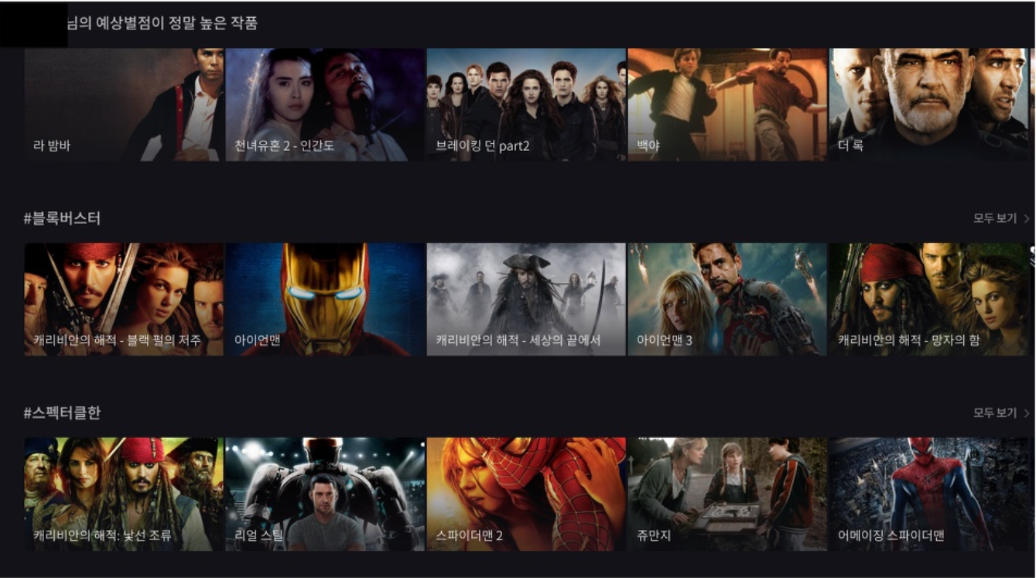
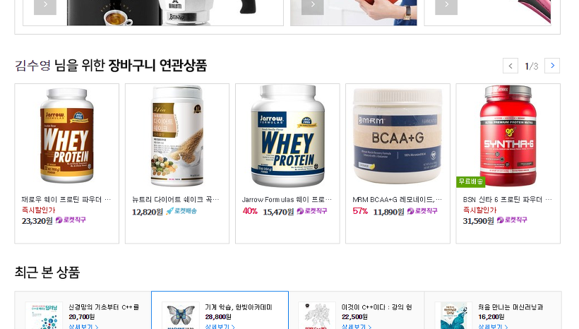
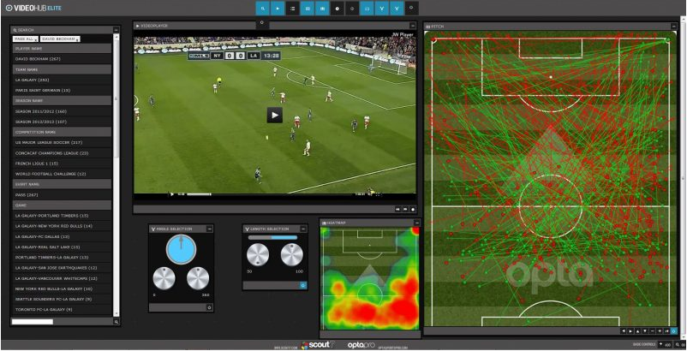
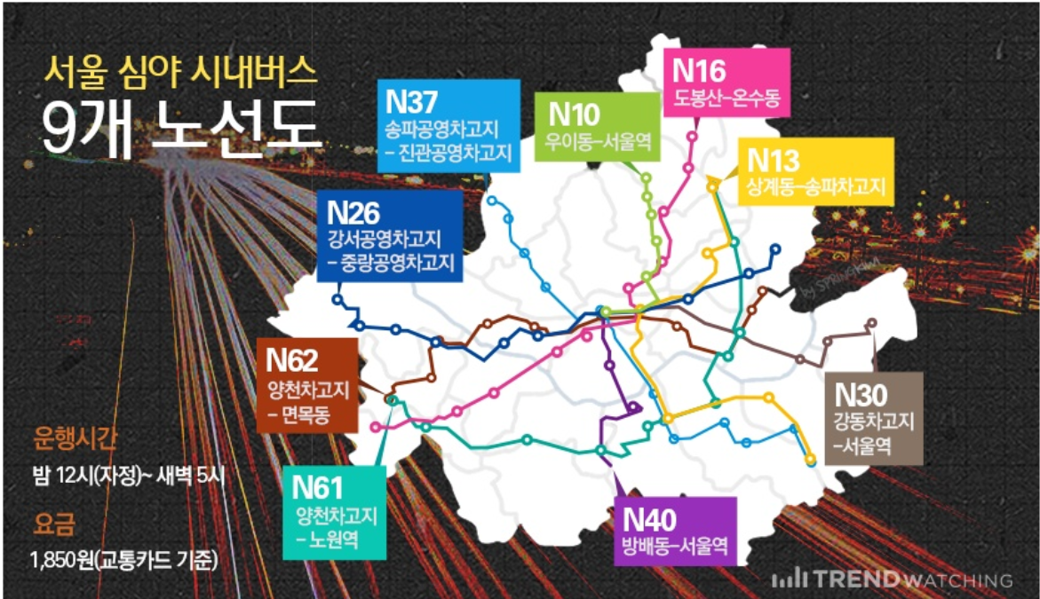
Data science around us
Recommendation sys. in Netflix
Coupang’s advertising sys.
Sports(soccer)
Night buses dispatching sys. in Seoul

Slide 5
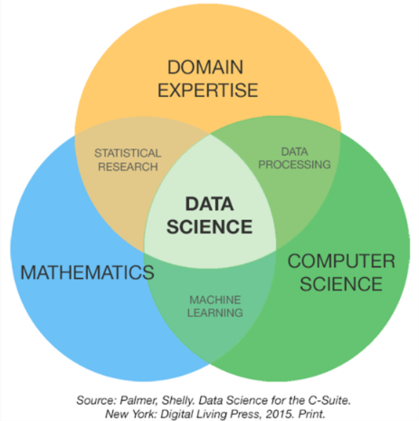
What is data science?
“Research area of scientific methods, processes and systems to extract knowledge and insight from large volumes of data that are structured or unstructured.

Slide 6
Data science & others
Data(base) management
Statistics
Business intelligence
Visualization
Data mining
Machine learning
Artificial intelligence

Slide 7
Regular data science tasks
Data analysis
Which products usually bought together?
What percentage of users back to our site?
Modeling / statistics
How many cars we are going to sell next year?
Which city is better for opening new office?
Engineering / prototyping
Make a system to use a prediction model
Visualization of analytics

Slide 8
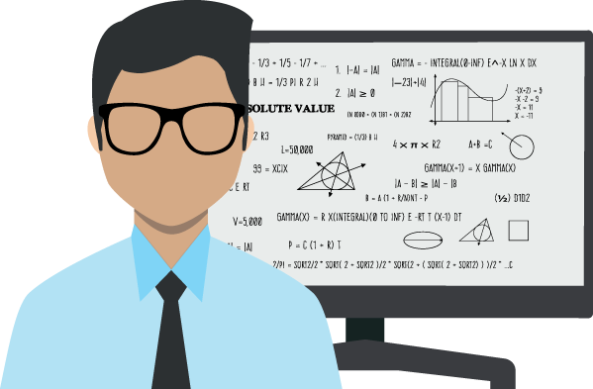
Who is a data scientist?
Scientist
Someone who find new discoveries.
Make a hypothesis.
Investigate and validate the hypothesis.
Data scientist
Make a hypothesis with data.
Look for meaning, knowledge in the data.
Answering questions based
on data.

Slide 9
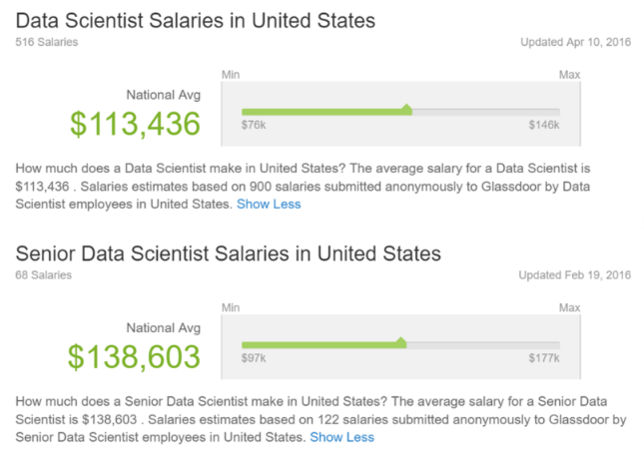
Data scientist as a job

Slide 10
Data dilemma
Cost vs. Value
How much it will cost for me to store and process the data?
How much value can I extract from the data?
Big data
No individual record is particularly valuable.
Having every record is incredibly valuable.

Slide 11
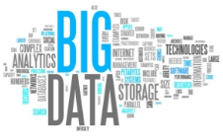
What is the big data?
No single standard definition
"Big data" is data whose scale, diversity, and complexity require new architecture, techniques, algorithms, and analytics to manage it and extract value and hidden knowledge from it...
- IMIA working group on "Data Mining and Big Data Analytics"
From R. Bellazi, IMIA Yearbook of Medical Informatics 2014

Slide 12
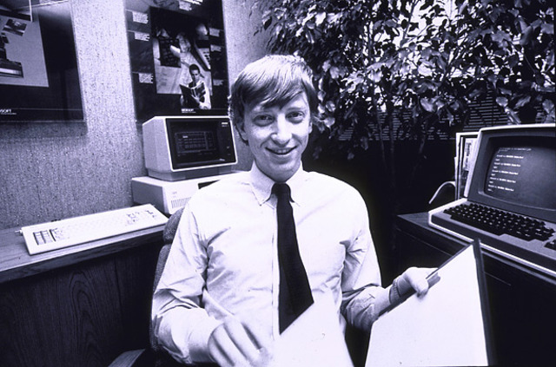
How much data?
Google processes 20 peta(10¹⁵) bytes (PB) a day (2008)
Facebook has 2.5 PB of user data + 15 TB a day (2009)
eBay has 6.5 PB of user data + 50 TB a day (2009)
"640kb ought to be enough for anyone." - Bill Gates in 1981

Slide 13
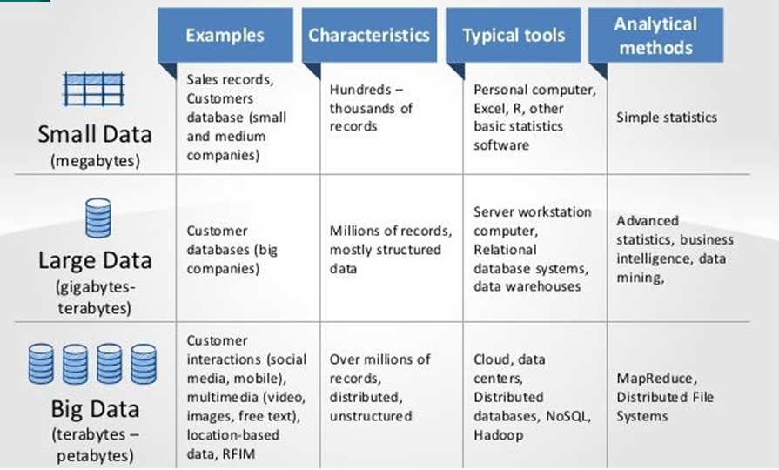
Data size

Slide 14
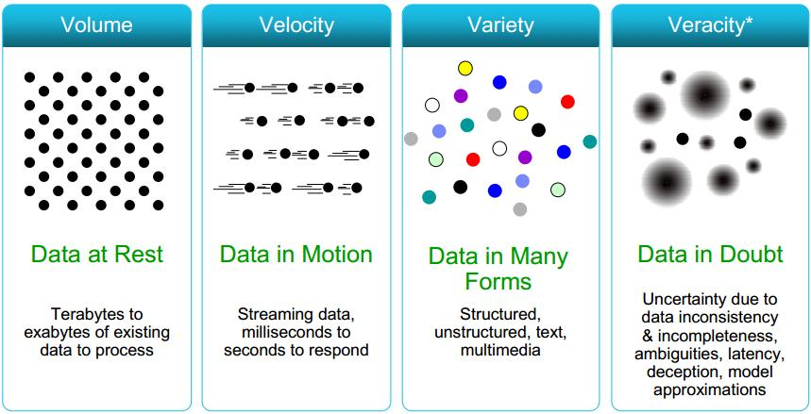
Characteristics of big data
5V?
Value : New value can be added or created by analyzing big data

Slide 15
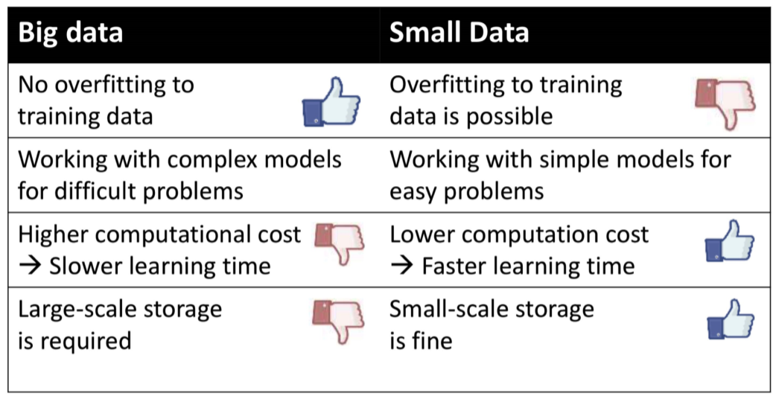
Advantages and disadvantages by data size

Slide 16
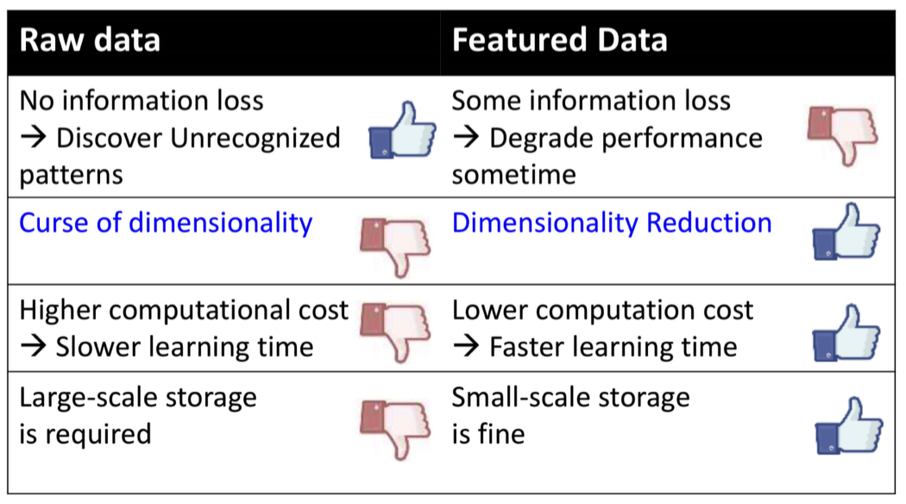
Reasons for processing big data

Slide 17

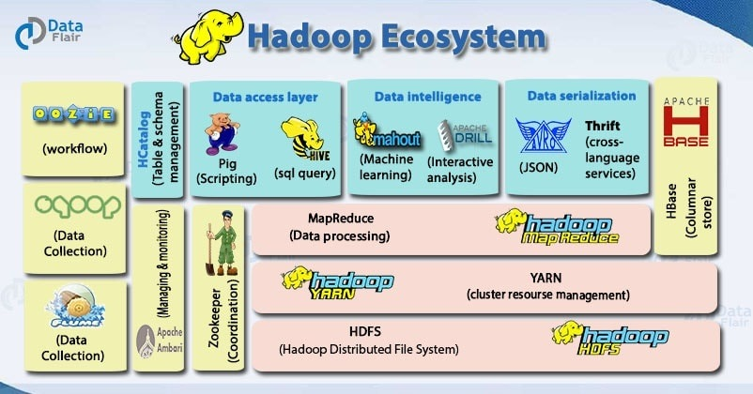
Platform of big data: Hadoop
Java-based open source framework for distributing large amounts of data
Provide services for data storage, data processing, data access methods, data governance, security and operations.
Ecosystem

Slide 18

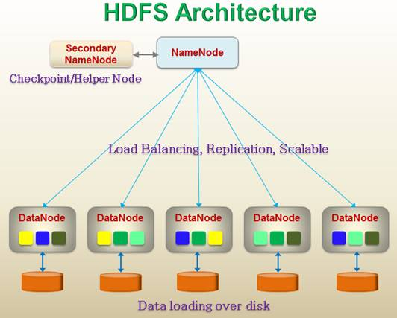
Hadoop Distributed File System (HDFS)
A file system for storing and managing big data across multiple servers (Hadoop cluster)

Slide 19
Hadoop Distributed File System (HDFS)
Tasks for failure management
Monitoring
A continuous “heartbeat” communication between the data nodes to the name node
Rebalancing
A process of automatically migrating blocks of data from one data node to another when there is free space
Managing integrity
Uses checksums, which are effectively "digital signatures" associated with the actual data stored in a file
Snapshot
Incremental copying of data to establish a point in time to which the system can be rolled back

Slide 20

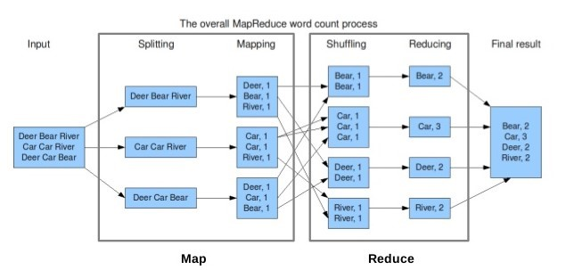
Hadoop: MapReduce
A method of processing data distributedly and in parallel within HDFS

Slide 21
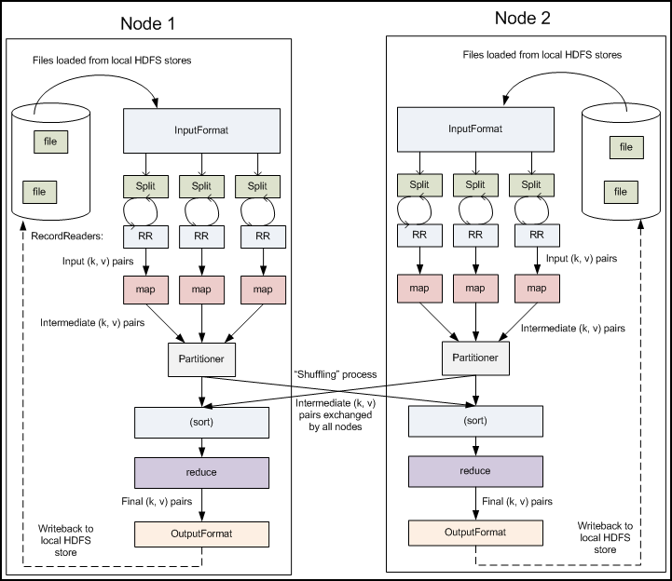
Hadoop: MapReduce

Slide 22
Data analysis methods
Statistical analysis (SA)
Summarize and describe data
estimate the meaning of the entire data from the sample data.
Machine learning (ML)
Machines automatically learn important patterns and rules from data, make decisions, make predictions, and more.
SA vs. ML
SA : outputs the dependent variable (Y) by inputting the independent variable (X) and the mathematical model.
ML : builds a model by inputting the independent variable (X) and the dependent variable (Y, label).

Slide 23
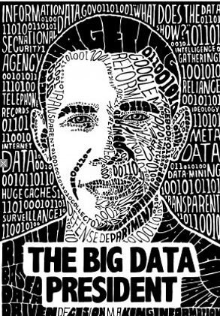
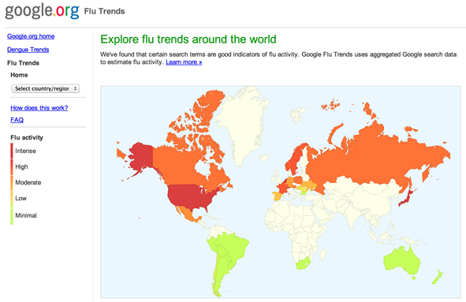
Big data success stories (1)
U.S. presidential election, Barack Obama
Amazon, Google and Facebook Advertising System
Give ads according to customer's preferences, search patterns, purchase pattern, etc.
Google's Flu Trend (2012)
Wal-Mart Increases Return on Investment through Data Analysis
Investigate consumer's
consumption patterns and
incorporate them into the
operation of the store

Slide 24
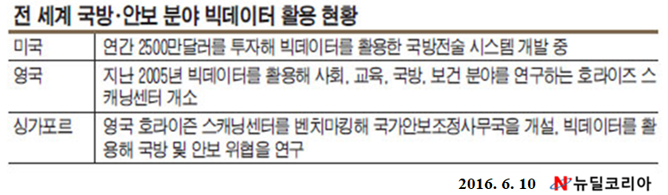
Big data success stories (2)
Boston Police Department, arrests terrorists using big data analysis
In military domain
Veteran Suicide Prevention System
http://durkheimproject.org/
etc
Notes:
◊ 영국의 호라이즌 스캐닝 센터(The Foresight HSC)
○ 최신 과학이론과 데이터 등 증거기반의 정책분석 서비스를 제공하고 정부의 혁신적 전략 및 중장기 미래 정책개발을 지원하기 위해 2005년 수립 - 주요기능
- 미래신성장동력 발굴(Future Projects) : HSC는 다양한 주제와 이슈들의 연관분석을 통해 10~15년 이후 미래를 전망
- 미래연구역량강화 및 기법개발(Training and tools) : HSC는 정부의 미래전략 및 정책 개발을 위해 필요한 미래 분석 가이드 및 방법론 제시
- 시그마 스캔(Sigma Scan) : STEEP(정치·경제·사회·환경·기술)별로 50년 이후의 정책 이슈를 포괄하는 연구 및 정책 보고서 검색 서비스
- 미래연구 분석가 네트워크 구축 : 호라이즌 스캐닝과 미래연구자들간의 인적 네트워크
○ 주요성과사례
- 영국인의 비만 문제가 사회를 위협하는 중요한 사항으로 판단하고, 과학적 근거를 기반으로 비만대책을 수립(Tackling Obesities : future choices)
- 사면이 바다인 영국의 지정학적 특성으로 인해 해수면 상승으로 인한 위험 등 발생가능한 잠재적 위험을 파악하여 30~100년 이후를 대비한 위험관리 프로젝트(Future Flooding)를 추진
- 글로벌 차원으로 확산되는 동식물 및 인간 전염병 확산에 대한 문제를 효과적으로 대응하기 대응책을 제시

Slide 25
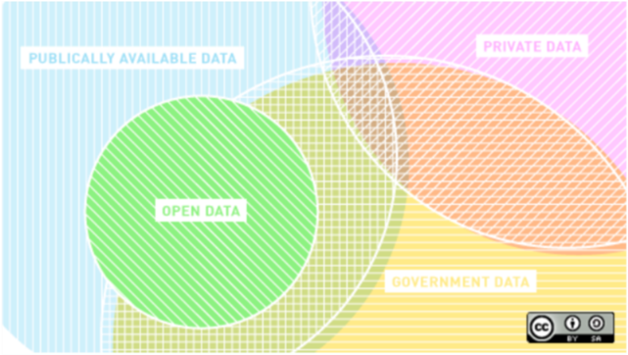
Data sources
Some of the best data is open data
국가 공공데이터 포털 : www.data.go.kr/
데이터 분석 경진 웹사이트 : www.kaggle.com/
국방 빅데이터 포털사이트 : bigdata.mnd.mil/

Slide 26
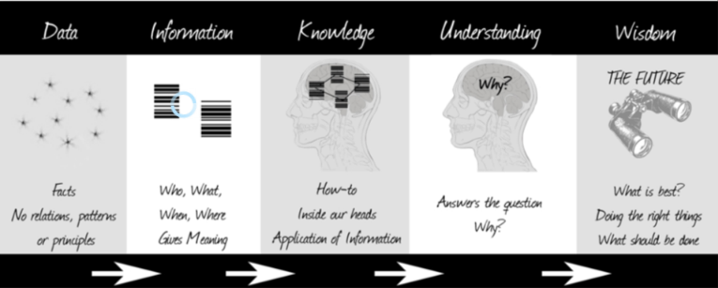
From data to wisdom
Analysis, statistics and/or machine learning works on the data

Slide 27
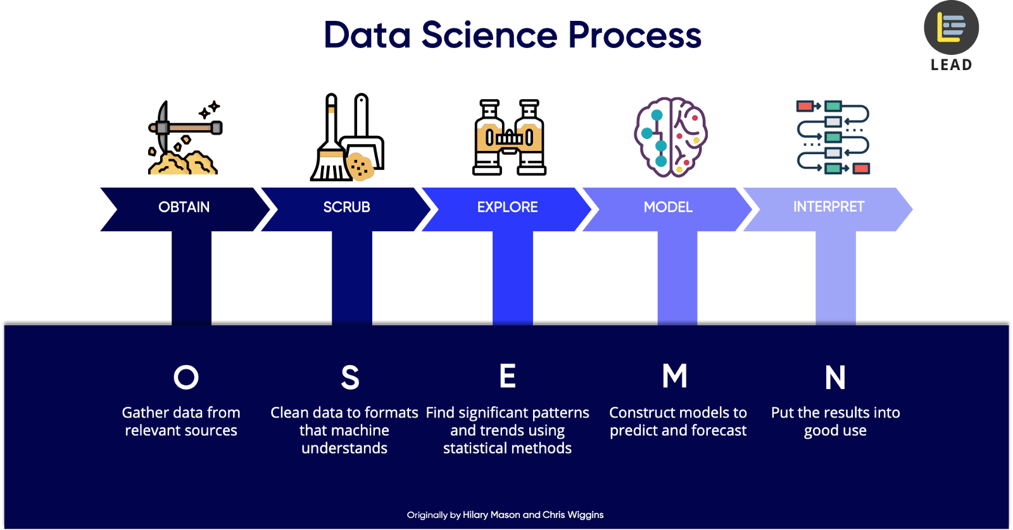
Typical process of data science

Slide 28
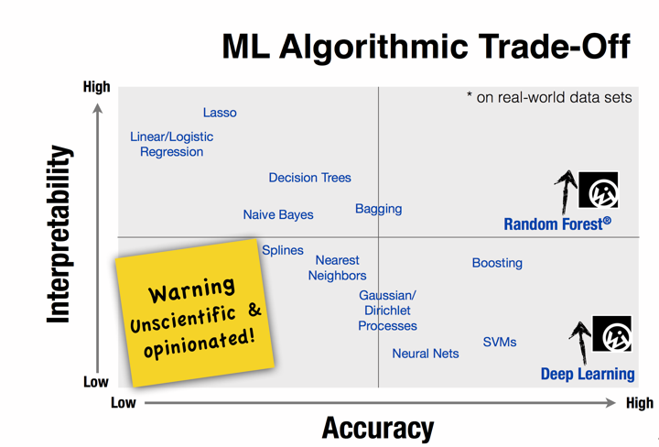
Considerations in constructing a model
Accuracy
required learning (training) time
Linearity (interpretability)
# of parameters, functions, etc.

Slide 29
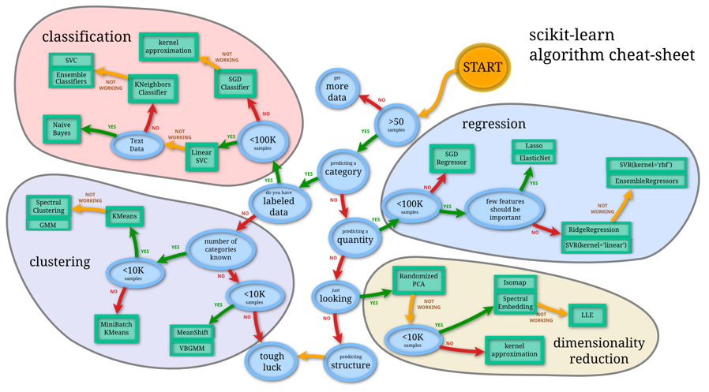
Example of algorithm selection cheat sheet
* source : http://scikit-learn.org/stable/tutorial/machine_learning_map/index.html

Slide 30



Next class
Experimental environment setup

Slide 31

Q & A

